Slide 1
Signal Processing
Tirgul 5 – Cross-Correlation, Circular convolution, ISI and PSTH

Slide 2
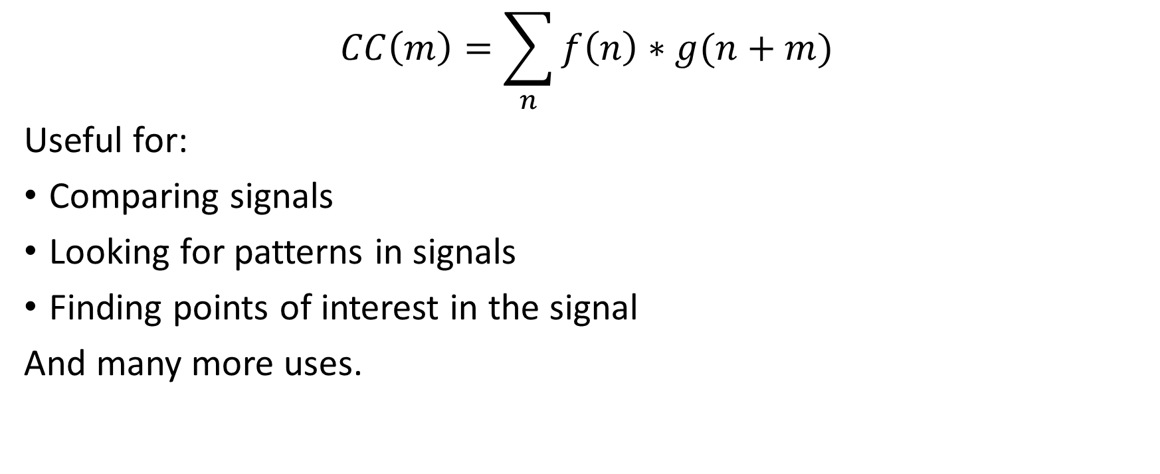
Cross Correlation

Slide 3
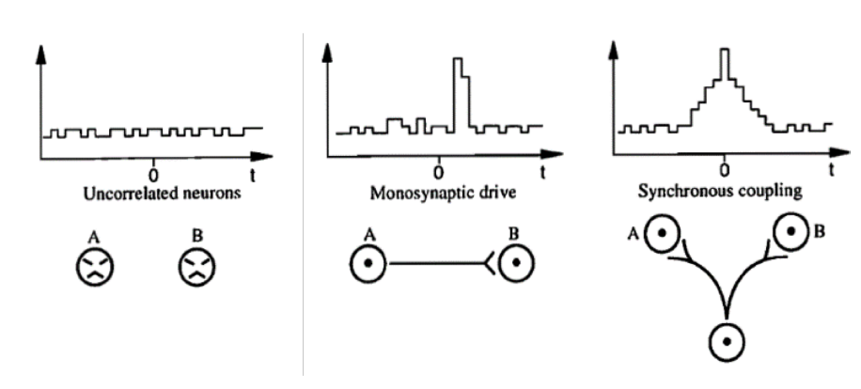
Using CC to discover connections between neurons

Slide 4
Cross correlation – Example 1
Draw schematic cross correlation graphs between all 3 neurons in the following network:
A
Excitation
Excitation
B
C

Slide 5
Cross correlation – Example 1
A->B
Cross-correlation
3
A
0
Lag (ms)
Excitation
Excitation
3ms
3ms
A->C
Cross-correlation
B
C
3
0
Lag (ms)
B->C
Cross-correlation
0
Lag (ms)

Slide 6
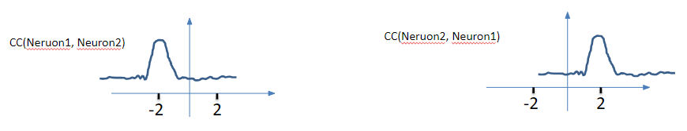
Important!
Neuron #1
Neuron #2

Slide 7
Cross correlation – Example 2
Draw schematic cross correlation graphs between all 3 neurons in the following network:
A
Excitation
Inhibition
5ms
5ms
B
C

Slide 8
Cross correlation – Example 2
A-B
Cross-correlation
5
0
A
Lag (ms)
Excitation
Inhibition
5ms
5ms
B
C
A-C
Cross-correlation
0
Lag (ms)
5
B-C
Cross-correlation
0
Lag (ms)

Slide 9
Cross correlation – Example 3
Draw schematic cross correlation graphs between all 3 neurons in the following network:
A
Excitation
Excitation
5ms
5ms
B
C
Inhibition
5ms

Slide 10
Cross correlation – Example 3
A
A-B
Cross-correlation
5
Excitation
Excitation
0
5ms
5ms
Lag (ms)
B
C
Inhibition
5ms
A-C
Cross-correlation
5
5
0
Lag (ms)
B-C
Cross-correlation
0
5
Lag (ms)

Slide 11
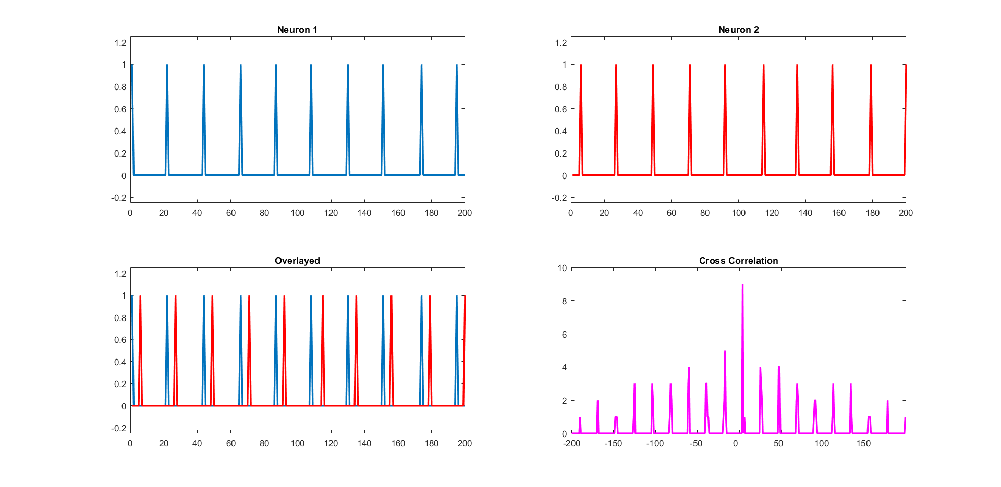
Code example

Slide 12
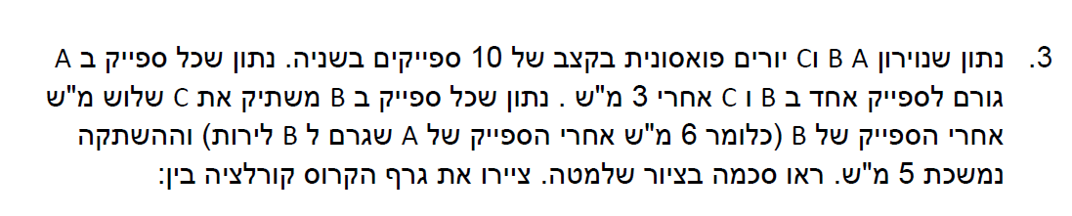
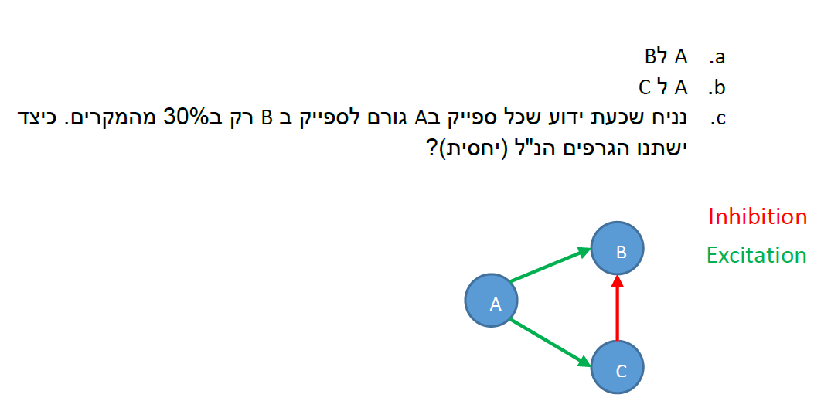
Exam example

Slide 13
Exam example
A->B
30
Probability (%)
3
Lag (ms)

Slide 14
Probability and jitter of connection
A->B
30
Probability
Probability (%)
3
Lag (ms)
Jitter (or variability)

Slide 15
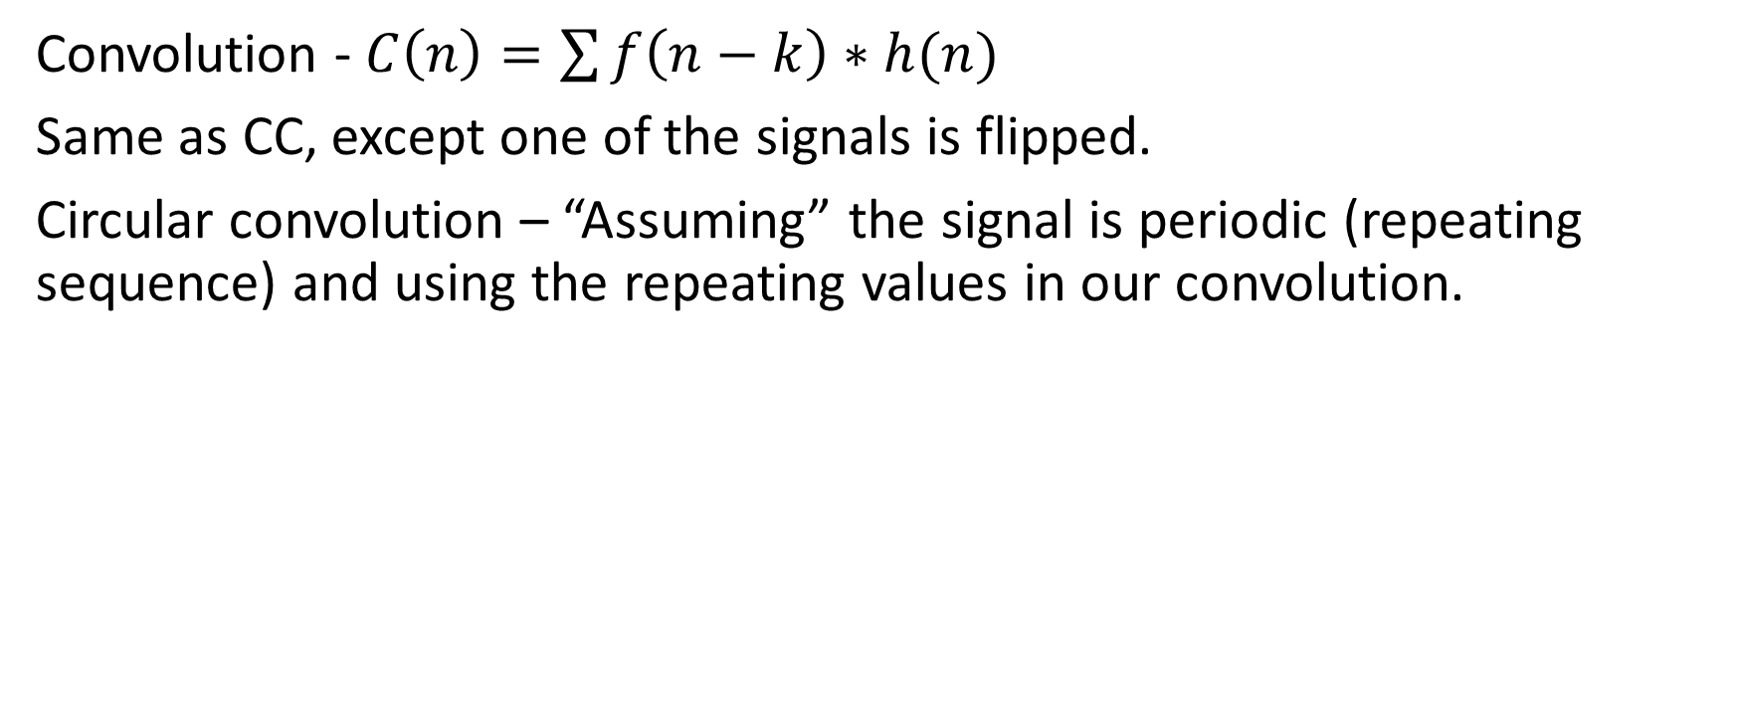
Circular convolution

Slide 16
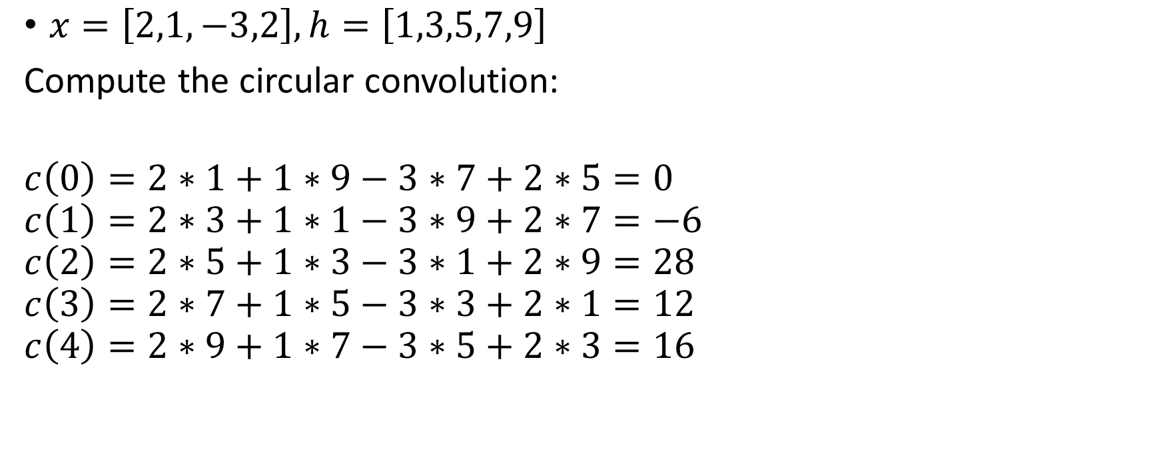
Circular convolution - Example

Slide 17
ISI – Inter Spike Interval
The time between two following spikes in a spike train. We can generate a histogram from all the ISIs in our signal.
For a poisson neuron, it follows an exponential distribution.

Slide 18
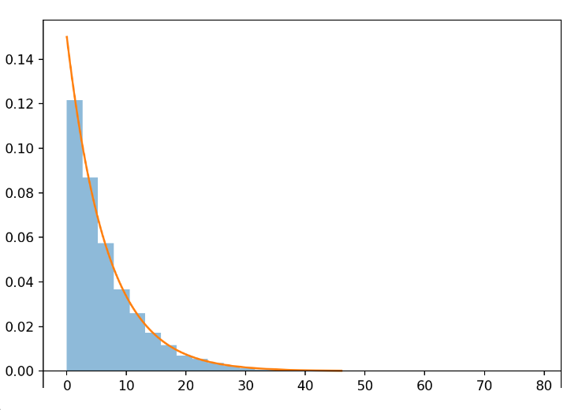
Poisson neuron
In a Poisson process, the probability of observing a spike at a given time is independent of the past spike times and is determined solely by the average firing rate of the neuron.
The average firing rate, often denoted by λ (lambda), represents the average number of spikes emitted by the neuron per unit time.
In a Poisson neuron, the ISI distribution can be described by an exponential distribution
P(ISI = t) = λ * exp(-λ * t)
where λ is the average firing rate and t is the time interval.
The mean of the distribution is 1/λ

Slide 19
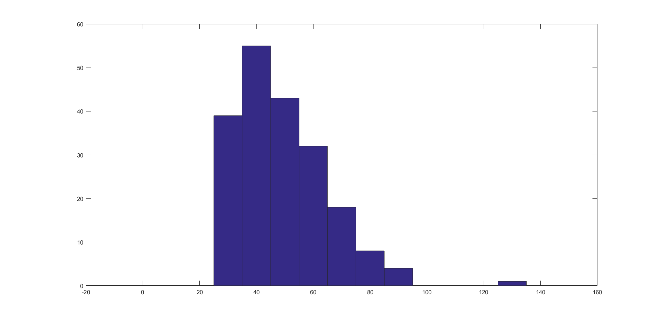
ISI – Code example
isi = np.diff(np.where(spike_train_1 == 1))
Count
Time (ms)

Slide 20
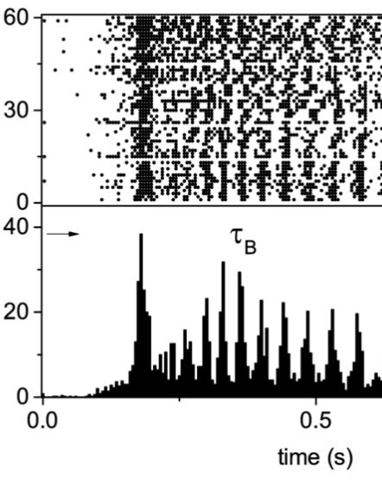
Raster plot
Displays the entire behavior (all repetitions/trials) of our neuron aligned on something, typically the onset of a stimulus.
Trials
0
1
Time (sec)

Slide 21
PSTH – Peri-Stimulus Time Histogram
Displays the average behavior of our neuron in the time period around an external event, typically the response to a stimulus.
Firing rate (Hz)
0
Time (sec)
1

